Slide 1
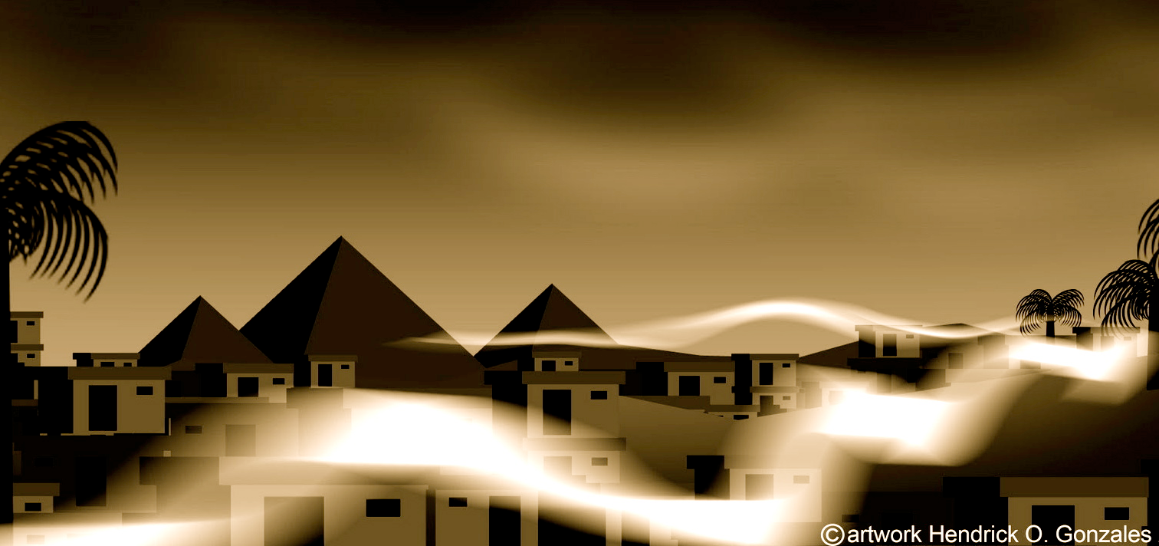
Pesach
Passover Seder

Slide 2
The holiday of Passover, or Pesach, begins during the full moon in the first month of the year, namely on the 14th day of Nisan. Passover is called the “Feast of Freedom” since it celebrates the deliverance of the Israelites from bondage in Egypt and memorializes the night when the faithful were protected by the blood of the lamb - a clear picture of the sacrifice of Yeshua the Messiah- the “Lamb of God who takes away the sins of the world” (John 1:29).

Slide 3
The Book of Exodus recounts how the LORD sent Moses to Pharaoh to serve as the deliverer of Israel. The Pharaoh, of course, refused Moses’s appeal to set the Israelites free from their slavery, and the stage was then set for the showdown between the God of Israel and the so-called “gods” of Egypt.

Slide 4
The final terrible plague that would descend upon the people of Egypt would be the death of the firstborn in the land. Only those families that sacrificed an unblemished male lamb and smeared its blood upon the doorposts of the house would be “passed over” - pesach - from the impending wrath from heaven.

Slide 5
God commanded that a few days before the Passover, each head of household should set aside a young male lamb to be examined for blemishes and to ensure its fitness as an offering. Interestingly, this allowed time for each family to become personally attached to their lamb, so that it would no longer simply be “a lamb” but rather their lamb.

Slide 6
On the afternoon of the 14th, the lamb was to be slaughtered and its blood smeared on all three sides of the doorframe. Even though the entire nation was responsible for the death of the lambs, each family was to personally apply its blood upon their own doorpost as a sign of their faith in the coming deliverance (Exod. 12:1-7).

Slide 7
That night, Nisan 15th, the meat of the Passover was to be roasted and eaten with unleavened bread, matzah, and bitter herbs. The meal was to be eaten in haste, since the Jews were to be ready to begin their journey immediately after God smote the firstborn. God “passed over” those homes whose doorposts were marked with the blood of the Passover lamb.

Slide 8
God further commanded that Passover should be commemorated annually as a reminder of the deliverance from Egypt. Only unleavened bread is to be eaten for seven days, and the first and seventh days of Passover are to be days of holy assembly on which all work is forbidden.

Slide 9
The Passover Seder occurs on “Erev Pesach,” the evening of Nisan 14, which then becomes Nisan 15 during the Seder ceremony at sundown. This agrees with the commandment given in the Torah, “In the first month, from the fourteenth day of the month at evening, you shall eat unleavened bread until the twenty-first day of the month at evening” (Exod. 12:18).

Slide 10
During Passover no chametz, leavened products, may be eaten or be found within your home for a full seven days. Preparing for Passover involves cleansing your house of all chametz.

Slide 11
Passover is called zman cheruteinu, the season of our freedom. Many people think “freedom” means being able to do what they want to do, when they want to do it, but that is not the Torah’s idea of freedom. Yeshua told us “whoever commits sin is the slave of sin,” and went on to say “if the Son sets you free, you will be free indeed” (John 8:34-36). True freedom is therefore moral and spiritual rather than physical. Freedom has to do with the ability to choose what is right and good.

Slide 12
In Hebrew, these two ideas of freedom are expressed using different words. The Hebrew word chofesh connotes freedom from external restraints, “doing your own thing”, while the word cherut suggests the freedom to do what you should, or the having the power to act responsibly. Cherut, then, is the sort of freedom that God wants to give to us. Our deliverance is meant to clothe us with the power to walk in righteousness and truth.

Slide 13
We gather together to share the collective experience of the Jewish people, whom God liberated from slavery in ancient Egypt to become His own treasured possession. The traditional ceremony for remembering this deliverance is called the seder, a Hebrew word that means “order.” A Passover seder refers to an orchestrated ceremony or liturgy with a number of distinct phases or steps.

Slide 14
During our seder we will eat special foods that help retell the story of the Israelites’ journey from slavery to freedom, and we will see how Yeshua used the rituals of the Passover Seder to explain the meaning of the new covenant, by revealing His sacrificial role as the Lamb of God who takes away the sins of the world.

Slide 15
Retelling and remembering the great story of the redemption from Egypt is central to the holiday of Passover, though Messianic believers further understand Passover to portray the universal deliverance given to the world through Yeshua the Messiah.

Slide 16
Just as the blood of the Passover lamb caused the physical plague of death to “pass over” the homes of the Israelites who trusted in God’s redemption, so the blood of Yeshua the Messiah, the great “Lamb of God,” causes the spiritual plague of death to pass over the homes of all those who likewise put their trust in Him.

Slide 17
“Each person in every generation must regard himself or herself as having been personally freed from Egypt.” Tonight’s seder is not just a retelling of an ancient story, but rather we are invited to experience the bitterness of oppression and the sweetness of salvation so that we may savor the great things the LORD our God has done for us in the Messiah.

Slide 18
Reader 1: This day shall be for you a memorial day, and you shall keep it as a feast to the LORD; throughout all your generations, as a statute forever, you shall keep it as a feast. (Exodus 12:14)

Slide 19
Reader 2: You shall observe this rite of Passover as a statute for you and for your children forever... And when your children say to you, ‘What do you mean by this service?’ you shall say, ‘It is the sacrifice of the LORD’s Passover, for He passed over the houses of the people of Israel in Egypt, when He struck the Egyptians.’ (Exodus 12:24-27)

Slide 20
Reader 3: Remember this day in which you came out from Egypt, out of the house of slavery, for by a strong hand the LORD brought you out from this place. (Exodus 13:3)

Slide 21
May God help us take our place at His table, remembering our true identity in Yeshua the Messiah: “Clean out the old leaven that you may be a new batch of dough, since you really are unleavened. For Messiah, our Passover Lamb, has been sacrificed. Let us therefore celebrate the festival, not with the old leaven, the leaven of malice and evil, but with the unleavened bread of sincerity and truth.” (1 Cor. 5:7-8)

Slide 22
On the table is a special “seder plate” which we will use as a “visual aid” to help us tell the story of Passover. Although there are different ways to arrange the ceremonial items on this plate, one arrangement is to order them according to the narrative of the events of the great Exodus from Egypt. In a sense, the entire Passover Seder will revolve around this plate and the symbolism of its items:

Slide 23
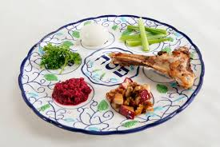
Karpas – A vegetable such as parsley that is dipped into salt water near the beginning of the Passover Seder. The presence of karpas represents the growth and fertility of the Jewish people in Egypt (Exod. 1:7).

Slide 24
Charoset – An apple, wine, and nut mixture that represents the mortar used by the Jewish slaves to build the storehouses of Egypt. Charoset symbolizes the toil and labor of the Jewish people in Egypt (Exod. 1:13-14).

Slide 25
Maror (ma - roar) – A bitter herb, such as horseradish, that symbolizes the bitterness and harshness of the slavery of the Israelites (Exod. 1:13-14).

Slide 26
Beitzah – A roasted egg that recalls the roasted lamb that was slaughtered at the Temple during the season of Passover (korban chagigah (ha-ge-ga).

Slide 27
Zero’a (zer - a) - A roasted lamb shank bone that symbolizes the sacrificed lamb whose blood was put upon the doorposts. Note that the usual word for “bone” is etzem in Hebrew, but the sages refer to
the lamb as zero’a - “arm” -
as in the “outstretched arm”
of the LORD. The “arm of
the LORD is evidenced in
His mighty deliverance of
the Jewish people given in
Yeshua!

Slide 28
Salt Water Bowl - The bowl of salt water recalls the sweat and tears of the Jewish slaves – it also recalls the splitting of the Sea and the destruction of Pharaoh’s army. We use the salt water to dip the karpas,
near the beginning of the Seder
and to dip the egg before the
start of the meal.

Slide 29
Nerot (nair - et)
We begin the Seder with the light and warmth of the Passover holiday candles. The eldest woman of the house traditionally lights the candles no later than 18 minutes before sundown on Nisan 14. After kindling the candles, she waives her hands over the flames three times as if welcoming in the holiday, and covering her eyes with her hands, so as not to see the candles burning says:

Slide 30
“Blessed art Thou, Lord our God, Master of the universe, who sanctifies us with Thy commandments, and commanded us to kindle the light of Shabbat and of the holiday.”

Slide 31
Reader 4: Since Yeshua was “born of a woman, born under the Torah,” it is fitting that a woman begins the Seder and brings light to the table...
Reader 5: As we look upon the candles, may we remember that Yeshua is the true Light of the world...

Slide 32
Since the Passover Seder centers on the Person and work of Yeshua as Seh ha-Pesach, the Passover Lamb of God, it is fitting to begin the Seder with an acknowledgement of His glory and presence. We therefore will open our Seder with a blessing that recognizes Him as the Source of all light and truth for our lives.
Let us all recite the following together:

Slide 33
Everyone
“Blessed are You, LORD our God, King of the universe, Who sanctified us with His commandments, and commanded us to be a light to the nations and Who gave to us Yeshua our Messiah the Passover Lamb.”

Slide 34
God established the mo’edim, or the “appointed times,” in order to reveal prophetic truth regarding His great plan of salvation given through the Messiah.
Let us thank Him for the divine calendar that He has revealed in the Scriptures:

Slide 35
Everyone
“Blessed are You, LORD our God, King of the universe, Who has given to us holidays, customs, and seasons of happiness, for the glory of our Lord Yeshua the Messiah, the Light of the world.”

Slide 36
2. Kadesh (ke - desh)
We will drink four cups of wine, each recalling a special promise made by God to our people:

Slide 37
Reader 1: “I am the LORD, and I will bring you out from under the burdens of the Egyptians, and I will deliver you from slavery to them, and I will redeem you with an outstretched arm and with great acts of judgment. I will take you to be my people, and I will be your God, and you shall know that I am the LORD your God, who has brought you out from under the burdens of the Egyptians” (Exod. 6:6-7).

Slide 38
These four promises are symbolized by four cups, traditionally referred to as follows:
The Cup of Sanctification
“I will bring you out from Egypt”
The Cup of Deliverance
“I will deliver you from Egyptian bondage”

Slide 39
The Cup of Redemption
“I will redeem you with My power”
The Cup of Restoration
“I will acquire you as My people”

Slide 40
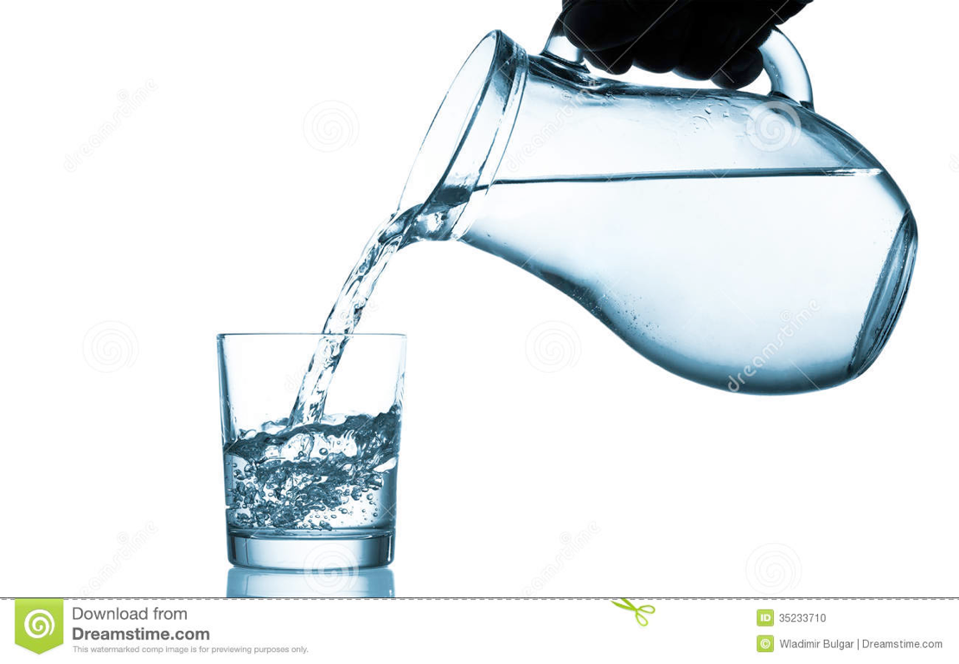
Each person will fill the cup of the person sitting to their left at this time, but don’t drink from them until you are told.

Slide 41
In Hebrew, the word for “holiness” is kedushah, meaning “set-apartness.” When God said that He would bring the Israelites out of Egypt, He separated them and set them apart as His own special people. During the Exodus, their passage through the cloud and the sea were likened to their “baptism” or rebirth as God’s people.

Slide 42
The first cup is called the “Cup of Sanctification” since it recalls how God has set us apart as His special people. This is the same cup over which we recite Kiddush on the Sabbath, except tonight we will recite it over the first cup of Passover.

Slide 43
Which cups did Yeshua drink during His Passover Seder with His disciples? He apparently drank the first two cups in the traditional way. At the third cup, the Cup of Redemption, He said: “This is My blood of the New Covenant” (Matt 26:27-39). Yeshua told His disciples that He would not drink the fourth cup, the Cup of Restoration, but promised to do so with them in the coming Kingdom (Matt 26:29).

Slide 44
Everyone
“And the evening and the morning were the sixth day. Thus the heavens and the earth were finished, and all the host of them. And on the seventh day God ended His work which He had made; and He rested on the seventh day from all His work which He had made. And God blessed the seventh day, and sanctified it: because that in it He had rested from all His work which God created and made.” (Gen. 1:31-2:3)

Slide 45
Reader 2: This is the Cup of Sanctification, remembering God’s promise: “I will bring you out from Egypt; I will set you apart...”
(Exodus 6:6)

Slide 46
“Blessed art Thou, LORD our God, King of the universe, Creator of the fruit of the vine.”

Slide 47
Everyone
“Blessed are You LORD, King of the Universe, who made us holy with His commandments and favored us, and gave us His holy Sabbath, in love and favor, to be our heritage, as a memorial of the Creation. It is the foremost day of the holy festivals marking the Exodus from Egypt. For out of all the nations You chose us and made us holy, and You gave us Your holy Sabbath, in love and favor, as our heritage. Blessed are You LORD, Who sanctifies the Sabbath.” - Amen

Slide 48
“Blessed are You, LORD our God, King of the Universe, who chose us from all peoples and exalted us from all tongues, and sanctified us with His commandments. And You gave to us, Lord our God, with love appointed times for gladness, festivals, and times for joy.”

Slide 49
The day of this festival of Matzah, the time of our freedom, is a holy convocation, a memorial of the Exodus from Egypt. For You chose us and sanctified us from all the nations and the festivals of Your holiness in gladness and in joy you gave us a heritage. Blessed are You, LORD, who sanctifies Israel and the seasons.

Slide 50
Everyone
“Blessed art Thou, Lord our God, Master of the universe, who has kept us alive and sustained us and has brought us to this special time.”

Slide 51
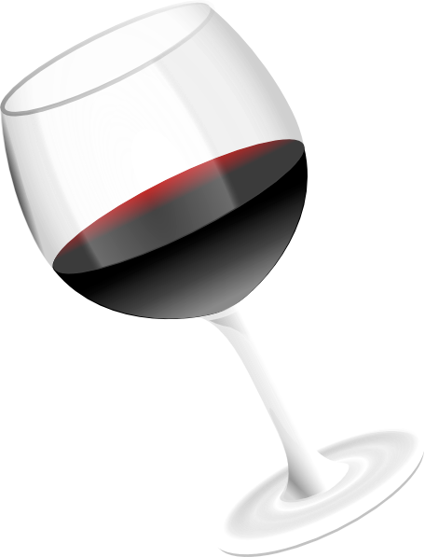
This first cup represents how God chose us to be His own treasured people: “I am the LORD, and I will free you from the burdens of the land of Egypt.”
Let us drink this first cup while leaning
or reclining to the left. We drink while
reclining to remind us that we do this in
our leisure and not as in the haste of the
first Passover.

Slide 52
3. Urchatz (oor - hotz)
Each person takes a turn pouring water from a vessel over the hands of the person next to him or her. It is customary to pour some water over the right hand three times, and then over the left hand three times. You will pour the water
over the hands of the person to your left.

Slide 53
It is likely that Yeshua washed His disciples feet during this step of the seder. Imagine the disciples passing the urchatz pan from person to person for the ritual cleansing of hands. Then,

Slide 54
Reader 3: “Yeshua laid aside His outer garments, and taking a towel, tied it around His waist. Then He poured water into a basin and began to wash the disciples’ feet and to wipe them with the towel that was wrapped around Him. He came to
Simon Peter, who said to Him, “Lord,
do You wash my feet?” Yeshua
answered him, “What I am doing, you
do not understand now, but afterward
you will understand.”

Slide 55
Reader 4: Peter said to Him, “You shall never wash my feet.” Yeshua answered him, “If I do not wash you, you have no share with Me.” Simon Peter said to Him, “Lord, not my feet only but also my hands and my head!” Yeshua said to him, “The one who has bathed does not need to wash, except for his feet, but is completely clean.

Slide 56
Reader 5: And you are clean, but not every one of you.” For He knew who was to betray Him; that was why He said, “Not all of you are clean.” When He had washed their feet and put on His outer garments and resumed His place, He said to them, “Do you understand what I have done to you?” (John 13:4-12)

Slide 57
4. Karpas
The fourth activity of our Passover Seder is to taste some karpas, a vegetable, often parsley, dipped into salt water.

Slide 58
The karpas symbolizes the growth and fertility of the Jewish people in Egypt, but it also remembers their great suffering. We eat karpas dipped in salt water to remember the tears that were shed during the time of oppression and slavery in Egypt. When you dip the karpas, shake off some of the salt water so that the drops will resemble tears....

Slide 59
Everyone
“Blessed art Thou, Lord our God, Master of the universe, Creator of the fruit of the earth.”

Slide 60
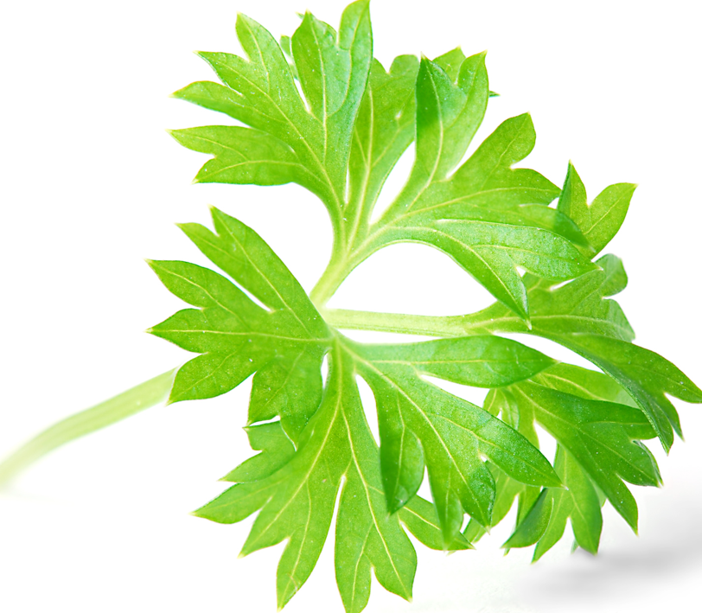
Pick up your parsley.
The karpas reminds us that it was springtime when the Exodus took place
Dip your parsley into the salt water
As you eat, remember the tears of
those who are in bondage today...

Slide 61
5. Yachatz (ya - hotz)
“This is the bread of suffering which our fathers ate in the land of Egypt.” All who are hungry -- let them come and eat. All who are needy -- let them come and celebrate the Passover with us.”

Slide 62
This is a Matzah Tosh bag. It has three pockets. Inside each pocket is a piece of Matzah.
These three matzah represent Abraham, Isaac and Jacob, respectively. The middle matzah, representing Isaac, will soon be broken to recall how he was sacrificed in obedience to his father - a picture of the sacrifice of Yeshua by God the Father.

Slide 63
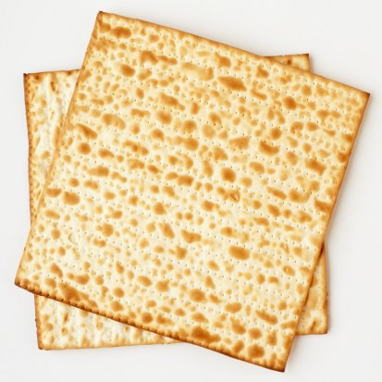
In Hebrew, the middle of something is its “heart.” When we break the middle matzah, we recall the broken heart of God for the pain Yeshua endured by taking our sins upon Himself at the cross.
(Pass matzah around the table and break off a piece)

Slide 64
Look at the matzah and see that it is striped: “By His stripes we are healed.”
Look at the matzah and see that it is pierced: “They shall look upon Me whom they’ve pierced.”
Look at the matzah, and see that it is pure, without any trace of leaven, as His body was without any sin.

Slide 65
Take a moment to reflect on the One who had no sin yet endured the cross for you and me.

Slide 66
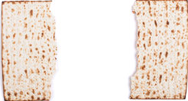
We are going to take the middle piece and break it as the body of Jesus was broken.
We are going to wrap the Afikomen in a burial shroud and bury it.

Slide 67
Reader 1: “For God so loved the world, that He gave His only Son, that whoever believes in Him should not perish but have eternal life.” ( John 3:16)
Reader 2: “For our sake He made Him to be sin who knew no sin, so that in Him we might become the righteousness of God.” (2 Cor. 5:21)

Slide 68
Consider how the Akedah provides a prophetic picture of the Lord Yeshua as the “Lamb of God” (Seh ha-Elohim) who takes away the sins of the world (John 1:29).

Slide 69
Both Isaac and Yeshua were born miraculously; both were “only begotten sons”; both were to be sacrificed by their fathers at Mount Moriah; both were to be resurrected (Gen. 22:5, Heb. 11:17-19); both willingly took up the means of his execution; and both demonstrate that one life can be sacrificed for another – the ram for Isaac, and Yeshua for all of mankind.

Slide 70
Some of the sages claim that the three matzah represent the people of Israel, the priests, and the Levites - instead of Abraham, Isaac, and Jacob. But why would the priests be depicted as “broken” in this case? Is not Yeshua the “high priest of our confession” who provided eternal redemption by means of shedding His blood in the Holy of Holies made without hands?

Slide 71
Why would the symbolism of a broken high priest be included in the Passover Seder? Did not the prophet Isaiah foretell that the Messiah would be “wounded for our transgressions,” “bruised for our iniquities,” and that “by His stripes we are healed”?

Slide 72
Consider that the broken matzah, the Afikomen, is an image of the Suffering Servant mentioned in the prophet Isaiah. Consider that this piece is taken, wrapped up, and carefully hidden from view, only to be discovered at the end of the Seder by little children.

Slide 73
This is an image of the death, burial, and resurrection of Yeshua from the dead. Only after partaking of the Lamb of God who was slain for our transgressions do we understand and take hold of the reward given to those who seek for Him.

Slide 74
At this time, please fill your cups for the second cup of our Seder....but don’t drink yet.
The Second Cup, called the Cup of Deliverance, is sometimes called the Cup of Plagues...

Slide 75
6. Maggid (ma - geed)
And it shall come to pass that your child will ask you, “What do you mean by this service?” And you shall tell him: “With a mighty hand, God took us out of Egypt...”

Slide 76
We are now ready to retell the story of our great redemption from slavery in Egypt. According to the Torah, we cannot eat our Seder meal until the story of how we obtained our freedom is retold to our children with joy and gratitude.

Slide 77
To help get the story going, we need the help of a young child to recite the “Four Questions” about this special evening. Let’s follow along as we consider the opening question regarding the purpose of our Passover Seder:
“Why is this night different from all other nights?”

Slide 78
Why is it that on all other nights during the year we eat either bread or matzah, but on this night we eat only matzah?
Why is it that on all other nights we eat all kinds of herbs, but on this night we eat only bitter herbs?

Slide 79
Why is it that on all other nights we do not dip our herbs even once, but on this night we dip them twice?
Why is it that on all other nights we eat either sitting or reclining, but on this night we eat in a reclining position?

Slide 80
So why is this night different from all other nights? On this night we celebrate one of the most important times in the history of Jewish people, when we went forth from slavery to freedom because of the mercy, love, and the great power of the LORD our God.
But before we retell that great story, let’s answer the four questions:

Slide 81
Why do we eat only matzah? For two reasons: first, to remember the bread of affliction we had to eat when we were slaves, and second, to remember how our ancestors fled Egypt in such a hurry that they did not have time for their bread dough to rise….

Slide 82
Why do we eat bitter herbs? We eat them to remind ourselves of how our ancestors’ lives were made bitter as slaves in Egypt.

Slide 83
Why do we dip our herbs twice? We dip karpas in salt water to remember the salty tears of the slaves, and also to remember how we crossed the salty waters of the sea. We also dip the maror in the charoset to remember how the bitterness of our slavery was made sweet by the hope for our freedom.

Slide 84
Why do we recline at the table? We recline tonight as a symbol of our freedom, for when we were slaves we could never recline in comfort.

Slide 85
Everyone
We were slaves to Pharaoh in Egypt.
But the LORD our God brought us out from there by a mighty and outstretched arm.

Slide 86
It is not enough to recall, in some abstract sense, the deliverance of the Jewish people in ancient Egypt, but each Jew is responsible to view Passover as a time to commemorate their own personal deliverance from slavery and bondage. Therefore the sages teach:

Slide 87
Reader 3: “In each and every generation an individual should look upon him or herself as if he or she personally had left Egypt.”

Slide 88
Because of this, let us all recite the following declaration:

Slide 89
Everyone
Had the Holy One, blessed be He, not taken out our forefathers from Egypt, then we, our children, and our children’s children would still be enslaved to Pharaoh in Egypt.

Slide 90
And since the redemption was meant to lead us to receive the Torah at Horeb, we affirm:

Slide 91
Everyone
Blessed is the Omnipresent, blessed be He! Blessed is He who gave the Torah to His people Israel. Blessed be He!

Slide 92
We are now ready, with God’s help, to begin the story of our journey from slavery to freedom, from sadness to joy, from death to life!

Slide 93
Reader 4: The story goes back to the very beginning, to the garden of Eden itself, when Adam and Eve disobeyed God and ate from the forbidden tree.

Slide 94
Reader 5: Because of their transgression, our original ancestors incurred the sickness of death and were exiled from the Divine Presence, though God graciously promised to heal them from the sting of death through the coming Seed of the woman – the Savior who would crush the serpent’s head.

Slide 95
Reader 1: Soon after making this promise, God clothed our original parents with the skin of a sacrificed lamb. The first “Passover” was in the garden...

Slide 96
Reader 2: The very first prophecy of the Torah concerns the promise of the coming “Seed of the woman” who would crush the head of Satan and remove the sting of death that was passed on to us through his venomous bite.

Slide 97
Reader 3: And the very first sacrifice of the Torah was that of a lamb, the hide of which was used to cover the shame of sin and death.

Slide 98
Reader 4: This was the original image of Passover – the “Lamb slain from the foundation of the world” who would offer Himself up so that we would be clothed in His righteousness.

Slide 99
Reader 5: At first Eve thought that her firstborn son Cain was the seed to come, but her hope was dashed after Cain killed his righteous brother, Abel. Adam and Eve’s firstborn son was a murderer, not a deliverer from the power of death.

Slide 100
Reader 1: Over time the original hope of deliverance began to fade away, and subsequent generations forgot their true origin and God’s great promise.

Slide 101
Reader 2: People began to vainly imagine that they were mere animals, subject to the influences of the stars and other forces of nature, and therefore, they invented gods, created idols, and dishonored themselves through strange religious rites.

Slide 102
Reader 3: Human beings became so filled with violence that God sent a flood to destroy the world. Only Noah and his family were spared.

Slide 103
Reader 4: After the great flood, Noah’s son Shem guarded the promise of the coming redemption and passed the legacy of his faith down to his children.

Slide 104
Reader 5: Unfortunately, Noah’s two other sons turned back to idolatry and built the Tower of Babel under the rule of a dictator named Nimrod. God confounded the language of the people, however, and the 70 Gentile nations were formed and dispersed throughout the earth...

Slide 105
Reader 1: But even the godly descendants of Shem eventually succumbed to idolatry. In ancient Mesopotamia, our ancestors likewise worshipped idols, until one man, Abraham, came to believe in the one true God.

Slide 106
Reader 2: A legend relates that Abraham’s father Terah sold idols for a living in the Mesopotamian city of Haran. When Abraham was a child, however, he realized that idol worship was foolishness. One day Abraham took a hammer and smashed all the idols - except for the largest one.

Slide 107
Reader 3: His father later demanded to know what happened. Abraham replied that the idols all “got into a fight” and the biggest idol won. His father was angry but understood that his son had discovered the truth of ethical monotheism.

Slide 108
Reader 4: Abraham heard the voice of the LORD calling him to leave his homeland to begin a new life in a land far away, where he would become a great nation.

Slide 109
Reader 5: Without knowing where he was going, Abraham took his wife Sarah and left the comforts of Babylon, eventually settling in the land of Canaan.

Slide 110
Reader 1: After Abraham rescued his nephew, Lot, from abduction by the kings of the plain, he met the mysterious Melchizedek, the King of Salem, who brought out bread and wine and blessed him.

Slide 111
Reader 2: Melchizedek was none other than Yeshua in his pre-incarnate state, the original Priest and King of the one true God. The bread and the wine foretold of the great redemption to come.

Slide 112
Reader 3: Soon after meeting with Melchizedek, God appeared to Abraham and told him he would become the father of a child in his old age.

Slide 113
Reader 4: When Abraham believed that the LORD would give him an heir – a “promised seed” - God counted him as righteous, and swore to make his descendants as numerous as the stars in the night sky and as the grains of sand on the seashore.

Slide 114
Reader 5: God ratified His promise to Abraham with a special covenant, but also gave him a dreadful vision of the future slavery and oppression of his descendants.

Slide 115
Reader 1: Then the LORD said to him, “Know for certain that your offspring will be sojourners in a land that is not theirs and will be slaves there, and they will be afflicted for four hundred years. But I will bring judgment on the nation that they serve, and afterward they shall come out with great possessions.”

Slide 116
Reader 2: In fulfillment of God’s promise of an heir, Abraham and Sarah had a son whom they named Isaac. After Isaac grew up, God tested Abraham by commanding Isaac to be sacrificed as a burnt offering.

Slide 117
Reader 3: After a three-day journey, Abraham and Isaac reached Mount Moriah (near Jerusalem), where Isaac allowed himself to be bound and placed on the altar.

Slide 118
Reader 4: When Abraham raised his knife to slaughter his beloved son, the Angel of the LORD called out for him to stop. Abraham then saw a ram, caught in a thicket by its horns, and offered it in Isaac’s place. Abraham called the altar Adonai-Yireh, “the LORD who Provides.”

Slide 119
Reader 5: Because of Abraham’ s obedience and Isaac’s willingness to become a sacrificial offering for sin, God made an eternal oath to bless the family forever... Today we blow the shofar to recall the sacrificial lamb that was given in place of Isaac.

Slide 120
Reader 1: Before he died, Abraham arranged to find a bride for his son from among his ancestors in Mesopotamia. Isaac married a young woman named Rebekah who eventually became pregnant with twin sons who violently wrestled within her.

Slide 121
Reader 2: When Rebekah asked the LORD what was happening, He told her that the younger son would be the chosen heir of the family - not the elder son. After the twins were born and raised, Rebekah helped Jacob to “steal” the blessing of the firstborn from Esau who then fled to live with his mother’s brother Laban in Aram.

Slide 122
Reader 3: While working for Laban, Jacob married Leah and Rachel, who – together with their handmaidens – bore him 12 sons and a daughter.

Slide 123
Reader 4: After years of being exploited and oppressed by Laban, Jacob and his family finally returned to the land of Canaan, though on the way home Jacob’s chosen wife Rachel died while giving birth to Benjamin.

Slide 124
Reader 5: Perhaps because of this, Jacob esteemed his son Joseph, Rachel’s firstborn and only other son, above his other sons and made him a colorful tunic indicating his special status in the family.

Slide 125
Reader 1: For his part, Joseph began having prophetic dreams indicating that he would be elevated above his other family members who would all bow down before him in homage.

Slide 126
Reader 2: Jacob’s other sons despised Joseph and eventually betrayed him. One day they stripped him of his colorful tunic and cast him into a pit, intending to kill him. When they saw some Midianite traders pass by, they decided instead to sell him as a slave for 20 pieces of silver.

Slide 127
Reader 3: The brothers took Joseph’s tunic and dipped it in blood, tricking their father, Jacob, into thinking that wild animals had killed him.

Slide 128
Reader 4: Meanwhile the Midianites took Joseph to Egypt where he was sold to an Egyptian officer named Potiphar, a servant of Pharaoh. Joseph fared well in Potiphar’s house until he was falsely accused of a crime and sent to prison...

Slide 129
Reader 5: While in prison, Joseph correctly interpreted the dream of Pharaoh’s wine steward, and two years later, when the Pharaoh was troubled about a dream, the steward recalled Joseph’s ability and commended him to Pharaoh.

Slide 130
Reader 1: The Pharaoh then called for Joseph, who listened to the dream and correctly interpreted it to mean that after seven years of plenty would come seven years of great famine upon the land.

Slide 131
Reader 2: When asked for his advice, Joseph recommended that food should be stored over the next seven years to prepare for the famine that would come. The king then appointed Joseph to oversee the entire project and named him Viceroy over all of Egypt.

Slide 132
Reader 3: The famine then came upon the land, and spread even to the land of Canaan. Jacob had heard there was grain stored in Egypt, so he sent his sons there to buy some food. Joseph recognized his brothers, but they did not recognize him. Joseph treated his brothers harshly and accused them of being spies.

Slide 133
Reader 4: After carefully testing to see if the brothers had really changed, Joseph finally revealed his identity to them and explained that the famine would last for several more years.

Slide 134
Reader 5: To escape the devastation, Joseph brought his father Jacob and his entire family to Egypt, to settle in the fertile land of Goshen where they would live as shepherds. There the family prospered and thrived, and the descendants of Abraham became as numerous as the stars in the night sky.

Slide 135
Reader 1: After the death of Joseph and the rest of the brothers, however, there arose a “new pharaoh” over Egypt who did not acknowledge Joseph’s contributions to the former regime, and who came to regard the Hebrews as a political threat.

Slide 136
Reader 2: Supervised by cruel taskmasters, the descendants of Abraham, Isaac, and Jacob were forced to build the storage cities of Pithom and Rameses.

Slide 137
Reader 3: Pharaoh made their lives bitter with hard labor, making bricks and mortar, and afflicting the Hebrews with forced labor.

Slide 138
Reader 4: Despite the afflictions imposed by the new Egyptian government, the Israelite population steadily increased, and the land was full of them. The Pharaoh then commanded the midwives to kill all Hebrew boys during their birth.

Slide 139
Reader 5: The midwifes refused Pharaoh, however, which then led him to decree that every Israelite baby boy found in Egypt was to be drowned in the Nile river.

Slide 140
Reader 1: During this time of horrible oppression, an Israelite woman named Yocheved hid her son to keep him alive. When the child could no longer be safely concealed, she placed him in a basket in the Nile River and the boy’s sister, Miriam, went to watch over him.

Slide 141
Reader 2: At just this time, Pharaoh’s daughter came to bathe in the river and found the basket. She adopted the baby and named him Moses, a name that means, “drawn out from the water.”

Slide 142
Reader 3: Moses grew up in the luxury of Pharaoh’s palace, a prince of Egypt. But he could not ignore the suffering of his people. One day he saw an Egyptian beating an Israelite slave, and in anger, he killed the Egyptian. Fearing for his life, Moses fled from Egypt and settled in the land of Midian, where he became a shepherd.

Slide 143
Reader 4: Many years later, Moses saw a bush that burned without being consumed. The LORD spoke to Moses from within the bush saying, “I AM the God of your ancestors, and I have seen the suffering of your people.” God then commanded Moses to return to Egypt to lead the Israelites to freedom.

Slide 144
Reader 5: Moses and his brother Aaron then went before Pharaoh with the message of the LORD: “Let My people go...” But Pharaoh refused, and instead made the Israelite slaves work even harder by making bricks without straw. Because of the hardness of Pharaoh’s heart, God began to bring a terrible sequence of plagues upon the land, revealing the impotence of the gods of Egypt.

Slide 145
At this point in our story, before we tell of the ten plagues, we will pause and recite the following words:

Slide 146
Everyone
These are the plagues that the Holy One, blessed be He, sent upon the Egyptians in Egypt.

Slide 147
As each plague is named in our retelling, we will dip our finger into our wine and spill a drop of wine, signifying that the suffering of the Egyptians lessens our joy:
When you see the blood drop, this is when we will spill the blood.

Slide 148
Reader 1: So Moses and Aaron met Pharaoh in the morning, while he was washing himself. ‘So far, you have refused to let my people go,’ they said. ‘Now thus says the Lord, “By this you shall know that I am the Lord: behold, with the staff that is in my hand, I will strike the water that is in the Nile, and it shall turn into blood. The fish in the Nile shall die, and the Nile will stink, and the Egyptians will grow weary of drinking water from the Nile.”

Slide 149
Reader 2: Moses and Aaron did as the Lord commanded. In the sight of Pharaoh and in the sight of his servants, Aaron lifted up the staff and struck the water in the Nile, and all the water in the Nile turned into blood.

Slide 150
Reader 3: For the babies who were drowned in the Nile – Blood! Blood! Blood!

Slide 151
Reader 4 : But Pharaoh was unmoved by this plague, and hardened his heart...

Slide 152
Reader 5: So Moses and Aaron met Pharaoh again and said, “Let my people go, that they may serve me. But if you refuse to let them go, behold, I will plague all your country with frogs.

Slide 153
Reader 1: The Nile shall swarm with frogs that shall come up into your house and into your bedroom and on your bed and into the houses of your servants and your people, and into your ovens and your kneading bowls. The frogs shall come up on you and on your people and on all your servants.”

Slide 154
Reader 2: Moses and Aaron did as the Lord commanded. In the sight of Pharaoh and in the sight of his servants, Aaron lifted up the staff and the frogs came up and covered the land of Egypt.

Slide 155
Reader 3: For the cries and groans of our people – Frogs! Frogs! Frogs!

Slide 156
Reader 4: But Pharaoh was unmoved by this plague, and hardened his heart...

Slide 157
Reader 5: And because the Pharaoh refused to relent, God continued to bring terrible plagues upon the land, displaying His mighty and outstretched arm.

Slide 158
For the constant oppression of our people – Lice! Lice! Lice!
For the attacks of the taskmasters – Swarms! Swarms! Swarms!
For treating animals better than our people –Pestilence! Pestilence!

Slide 159
For the toil and injury of our people – Blisters, ulcers, tumors!
For the dread our people felt - Hail mixed with fire!

Slide 160
For forgetting how Joseph had saved Egypt – Locusts! Locusts! Locusts!
For worshipping the sun god Ra – Darkness! Darkness! Darkness!

Slide 161
After the ninth plague, God gave Moses instructions regarding the sacrificial rite of Passover: “Tell the congregation of Israel that on the tenth day of this month (i.e., Nisan 10) every man shall take a lamb without blemish, a male a year old, and shall keep it until the fourteenth day of this month, when the whole assembly of the congregation of Israel shall kill their lambs in the afternoon.

Slide 162
Then they shall take some of the blood and put it on the two doorposts and the lintel of the houses in which they shall eat it.”

Slide 163
“The blood shall be a sign for you... And when I see the blood, I will pass over you, and no plague will befall you to destroy you, when I strike the land of Egypt” (Exod. 12:13). The blood would be a sign for the Israelites, i.e., “for you,” and not for the Egyptians. Rashi says the blood was placed on the inside of the door – not the outside.

Slide 164
The Hebrew word for “sign” or “wonder” is also the word ot, which is also the general name for a Hebrew letter. Each letter of the Aleph-Bet, then, contains signs that point to Yeshua. Yeshua is the sign of the everlasting covenant with God.

Slide 165
The use of sacrificial blood was later enshrined in the rites of the Mishkan or Tabernacle using the principle, “the life is in the blood” (Lev. 17:11).

Slide 166
Reader 1: They shall take some of the blood and put it on the two doorposts and the lintel of the houses...
Reader 2: They shall eat the flesh that night, roasted on the fire, with matzah and bitter herbs they shall eat it in haste... It is the Lord’s Passover!

Slide 167
Reader 3: “For I will pass through the land of Egypt that night, and I will strike all the firstborn in the land of Egypt, both man and beast; and on all the gods of Egypt I will execute judgments: I am the LORD. The blood shall be a sign for you, on the houses where you are. And when I see the blood, I will pass over you, and no plague will befall you to destroy you...”

Slide 168
Reader 4: This day shall be for you a memorial day, and you shall keep it as a feast to the Lord; throughout your generations, as a statute forever. Seven days you shall eat matzah, for on this very day I brought your hosts out of the land of Egypt.

Slide 169
Reader 5: In the first month, from the fourteenth day of the month at evening, you shall eat matzah until the twenty-first day of the month at evening. For seven days no leaven is to be found in your houses. If anyone eats what is leavened, that person will be cut off from the assembly of Israel.

Slide 170
Reader 1: At exactly midnight, on the 15th of the month of Nisan, the Lord struck down all the firstborn in the land of Egypt, from the firstborn of Pharaoh who sat on his throne to the firstborn of the captive who was in the dungeon, and all the firstborn of the livestock.

Slide 171
Reader 2: And Pharaoh rose up in the night, he and all his servants and all the Egyptians. And there was a great cry in Egypt, for there was not a house where someone was not dead.

Slide 172
Reader 3: For the hardness of Pharaoh’ s heart – Death of the firstborn!
Reader 4: Only those houses that were marked with the blood of the Passover lamb were spared from the plague of death.

Slide 173
Reader 5: God had warned Pharaoh from the very beginning about the danger he was facing: “Thus says the LORD, Israel is My firstborn son, and I say to you, ‘Let My son go that he may serve Me,’ but if you refuse to let him go, behold, I will kill your firstborn son” (Exod. 4:22-23).

Slide 174
Reader 1: A great cry rose up from Egypt, since there was not a family among the Egyptians without one dead... In this state of utter devastation, Pharaoh finally agreed to let the Israelites go free...

Slide 175
Reader 2: Early the following morning, on Nisan 15, the great Exodus began! The Israelites left in such haste that their leavened bread didn’t have time to rise. As a result, we eat matzah on Passover.

Slide 176
Reader 3: Over 600,000 adult males, along with their wives and children, left Egypt along with a wealth of gold and silver that the Egyptians had given them.

Slide 177
Reader 4: Instead of leading the Israelites along a direct route to the Promised Land, however, God directed them south, into the desert. After three days, the Pharaoh hardened his heart yet again and led his army to bring them back.

Slide 178
Reader 5: When the Egyptians reached them two days later, the Israelites were caught between a rock and a hard place, with the Red Sea on one side, and Pharaoh’s army on the other. The people cried out to God for deliverance.

Slide 179
Reader 1: The Pillar of Cloud and Fire prevented the Egyptians from attacking the Israelites. God then told Moses to raise his staff to separate the waters, allowing the people to cross through the sea to safety on the other side. Once everyone was safely across, the Pillar lifted, allowing the Egyptian army to pursue the Israelites into the sea.

Slide 180
Reader 2: God then told Moses to lift his staff again so that the waters would overwhelm the Egyptians with their chariots and horsemen. By the time dawn arrived, the Israelites saw the dead bodies of Pharaoh’s army lining the seashore. It was finally over!

Slide 181
Reader 3: Israel was completely delivered. After witnessing this great miracle, Moses and the people sang a song of praise to God for their deliverance, and Miriam led the women in joyous dance...

Slide 182
Reader 4: And so began the Israelite’s journey from slavery to freedom, from sadness to joy, from being strangers in Egypt to becoming a great nation.

Slide 183
Reader 5: The crossing of the sea represented the birth of the new nation, redeemed by the blood of the lamb, on its way to receive revelation at Horeb...God delivered His people to reveal Himself to them as their Heavenly Father.

Slide 184
Reader 1: Moses later told the people, “Remember the day in which you came out from Egypt, out of the house of slavery, for by a strong hand the Lord brought you out from that place. No leavened bread may be eaten. Seven days you shall eat matzah, and on the seventh day there shall be a feast to the Lord.”

Slide 185
Reader 2: “You shall tell your son on that day, ‘It is because of what the Lord did for me when I came out of Egypt.’ And it shall be to you as a sign on your hand and as a memorial between your eyes, that the Torah of the Lord may be in your mouth. For with a strong hand the Lord has brought you out of Egypt.”

Slide 186
Reader 3: You shall therefore keep this statute at its appointed time from year to year. It is a night of watching for all generations.

Slide 187
Everyone
“Amen.”

Slide 188
The great story of redemption is revealed on two levels in Scripture - one that concerns the paradise of Eden, the universal level, and the other that concerns the paradise of Israel, the particular level.

Slide 189
Therefore Yeshua is both rightly called the “Lamb of God who takes away the sins of the world” (John 1:29) and “Messiah our Passover Lamb who has been sacrificed for us” (1 Cor. 5:7). Likewise He is both rightly called the “Seed of the woman,” and “the Son of David”; He is called the “Second Adam,” and the “King of the Jews,” and so on...

Slide 190
The story of Israel’s redemption in Egypt therefore serves as an allegory of both the universal salvation that was promised in Eden, the lamb slain from the foundation of the world as well as the revelation of the sacrificial ministry of Yeshua as Israel’s promised Messiah. Yeshua is both the Savior of the world as well as Israel’s true King and Deliverer.

Slide 191
Just as Eve’s doubt in God’s goodness gave Satan his advantage, so it was through her teshuvah - repentance - that she would find salvation. And just as it was through Adam’s sin that the plague of death came into the world, so it was through Yeshua’s sacrificial death that life and healing would come.

Slide 192
Yeshua was “bruised” through His sacrifice on the cross, but through it He crushed the head of the serpent and broke the fangs of his venomous sting. Access to the Tree of Life is now available in the renewed paradise of God. Yeshua is the Savior of the world and the One who rebuilds the fallen tabernacle of Eden.

Slide 193
Looked at from another perspective, Egypt represents the world system that enslaves people. As the ruler of this world, Pharaoh therefore represents Satan, the original serpent who deceived Eve in the garden.

Slide 194
Egypt therefore represents a state of exile similar to the original exile from Eden, and just as the blood of the lamb applied to the doorposts in Egypt caused the plague of death to pass over, so the blood of Yeshua saves us from the wrath of God and spiritual death.

Slide 195
Yeshua said that by nature people were in bondage to the dictates of this world system and its forces and needed to be set free. The Hebrew word for salvation means to be set free from the restrictions of “Egypt” and its forces.

Slide 196
Just as the Israelites were made free from the tyranny of Pharaoh when they crossed the Sea – being “baptized into the death of the waters” so they could be reborn to serve God in freedom – likewise those who trust in Yeshua are “baptized into His death” and reborn to serve God by the power of the Holy Spirit. Our redemption is meant to set us free to be God’s treasured people.

Slide 197
Let us thank the LORD our God for the miracle of our deliverance:

Slide 198
“Blessed be the LORD, the LORD God, the God of Israel, who makes us rejoice with psalms of praise!”

Slide 199
Reader 4: Praise the LORD! – Halleluyah!
Praise, O servants of the LORD, praise the name of the LORD!
Reader 5: Blessed be the name of the LORD from this time forth and forevermore!

Slide 200
Reader 1: From the rising of the sun to its setting, the Name of the LORD is to be praised!
Reader 2: The LORD is high above all nations, and His glory above the heavens!

Slide 201
Who is like the LORD our God, who is enthroned on high, who looks far down on the heavens and the earth? He raises the poor from the dust and lifts the needy from the ash heap, to make them sit with princes, with the princes of his people. He gives the barren woman a home, making her the joyous mother of children. Praise the LORD. (Psalm 113)

Slide 202
At this time, let us look at the shank bone on the Seder plate and give thanks to Yeshua our Messiah, the true Passover Lamb of God our Savior: Behold the Lamb of God, who takes away the sin of the world!

Slide 203
We are now ready to drink the second cup, the “Cup of Deliverance.” This cup recalls God’s second promise made to our ancestors: “I will deliver you from slavery.” Let us then give thanks to the LORD our God for saving the Israelites from Egypt and for delivering us from our personal bondage to the evil one by the shed blood of the Lamb of God... Let us lift our hearts to God in thanks for His salvation as we recite the blessing:

Slide 204
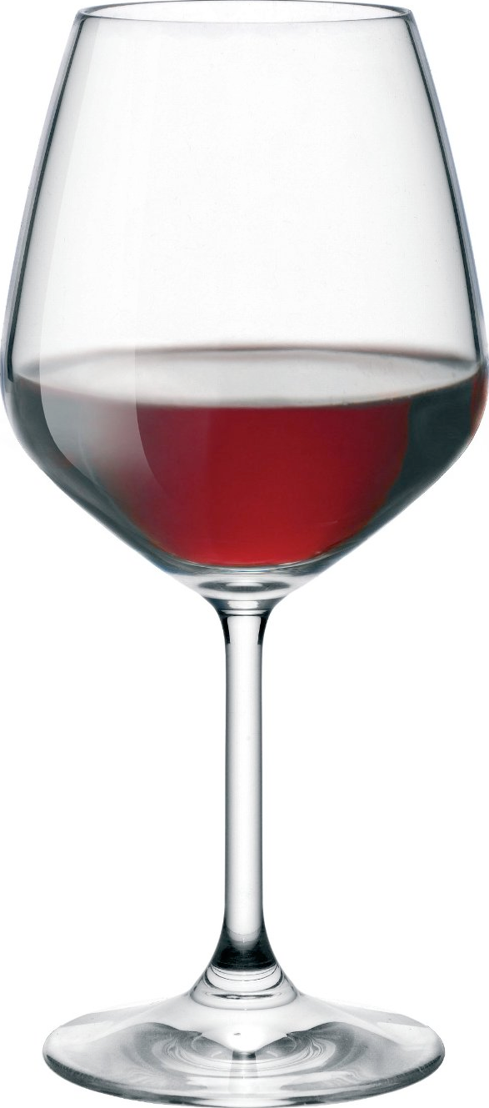
Everyone
“Blessed art Thou, LORD our God, King of the universe, Creator of the fruit of the vine.”
reclining to left

Slide 205
Of all the blessings we will recite this night, surely one of the most important is to thank God for the way of salvation given to us in His Son Yeshua, the great Lamb of God who takes away the sins of the world. Let us recite the following Hebrew blessing that offers thanks and praise to the LORD our God:

Slide 206
Everyone
“Blessed are You, LORD our God, King of the universe, Who gave to us the way of salvation
through the Messiah Yeshua, blessed be He.
Amen.”

Slide 207
The deliverance we have in Yeshua both clears us of guilt and sin while investing us with the power and righteousness of God through faith. We are “justified” in Yeshua - “just-if-I’d” never sinned - and “just-if-I’d” always obeyed.

Slide 208
This is the miracle of the “exchanged life” - the Korban Principle of the sacrificed Messiah for our deliverance (2 Cor. 5:21). Because of the great salvation given to us in the Messiah, we are no longer regarded as “slaves in the house” but rather are set free and made heirs of God through Yeshua our LORD.

Slide 209
7. Motzi Matzah
We are now ready to eat some matzah – but not just any matzah - but the very special matzah that represents our fathers Abraham and Isaac, the great patriarchs of our faith, who demonstrated the truth of God’s sacrificial love by the binding of Isaac upon the altar.

Slide 210
Before we eat of this special matzah, however, we will recite two traditional Hebrew blessings. First we will recite the familiar blessing over the bread, and then we will recite the blessing over the matzah, which will mark the start of our observance of the seven-day festival of Unleavened Bread.
First, then, let us all recite the traditional blessing over the bread:

Slide 211
Everyone
“Blessed art Thou, LORD our God, King of the universe, Who brings forth bread from the earth.”
Amen

Slide 212
Now we are ready to recite the blessing over the matzah, which marks the start of the seven-day festival of Unleavened Bread, recalling our first week after our great deliverance from bondage in Egypt.
Let us all recite the blessing over the matzah together:

Slide 213
Everyone
Blessed are You, LORD our God, King of the universe, Who sanctified us with His commandments, and commanded us to eat matzah.
(eat)

Slide 214
Note that during His Upper Room Seder with the disciples before He would be crucified, Yeshua distributed matzah pieces, so they could be dipped in the dishes on the seder plate:

Slide 215
Reader 3: When it was evening, He reclined at the table with the twelve. And as they were eating, Yeshua said, “Truly, I say to you, one of you will betray Me.”
Reader 4: And they were very sorrowful and began to say to Him one after another, “Lord, is it I?”

Slide 216
Reader 5: Yeshua answered, “He who has dipped his hand in the dish with Me will betray Me.”
Reader 1: Judas, who would betray Him, answered, “Rabbi, is it I?” Yeshua said to him, “You have said so.”

Slide 217
After this, Judas left into the night to betray our Lord and was therefore not at the Seder when Yeshua later sanctified the matzah, the Afikomen, and the Third Cup as the symbols of His body and blood sacrificed for our redemption...

Slide 218
We have now had our first taste of matzah for the seven-day holiday called Chag HaMatzot, the “Feast of Unleavened Bread.” The Lord clearly stated that we were to eat this bread, the “bread of affliction,” to commemorate the Exodus from Egypt:

Slide 219
Reader 2: The Egyptians were urgent with the people to send them out of the land in haste. For they said, “We shall all be dead.” So the people took their dough before it was leavened, their kneading bowls being bound up in their cloaks on their shoulders. (Exodus 12:33-34)

Slide 220
We are to remember how we ate only matzah from the time we left Egypt on Passover day until the day we crossed over the sea and left Egypt behind us:

Slide 221
Reader 3: Remember the day in which you came out from Egypt, out of the house of slavery, for by a strong hand the Lord brought you out from that place. No leavened bread may be eaten. Seven days you shall eat matzah, and on the seventh day there shall be a feast to the Lord. (Exodus 13:3, 6)

Slide 222
There is a connection between leaven - chametz - and Egypt. Apparently the Egyptians invented the idea of fermentation - yeast - for use with bread, and such bread was even used as a form of currency in their economy.

Slide 223
Leaven therefore represents the “rich man’s bread” - that is, the bread eaten by the taskmasters who oppress and exploit others for their own lusts. Leavened bread is the food of this evil world of which we are to be purged....

Slide 224
Leaven produces fermentation, which is a natural process of decay. The sages identify leaven with the yetzer hara, the evil impulse that gives “rise” to lusts of the flesh and the pride of life. Yeshua was completely without sin, entirely “unleavened,” that is, free from the curse of death and its corruption. He was not “puffed up” by sin but was “a lamb without spot or blemish” given for our Passover sacrifice (1 Pet. 1:19).

Slide 225
Moreover, after He was buried, Yeshua did not suffer the natural process of corruption - decomposition of the body. His body did not “return to dust” - the very curse given to Adam and Eve. As the “Second Adam,” Yeshua’s death “reversed the curse” by killing the power of sin and death through the sacrifice of Himself (Heb. 9:26).

Slide 226
The Apostle Paul instructed us to “purge out the old leaven” to keep the feast of Passover (1 Cor. 5:7-8), which means that we are to live in purity and separation from the corrupting influence of sin in our lives. Since we have been made “unleavened” - pure - by the sacrifice of Yeshua, our lives should reflect the inner purity of his heart....

Slide 227
Does this mean that we are supposed to flagellate ourselves in repentance? No, because unleavened bread is called the “bread of affliction” or “bread of humility”. Partaking of this bread means humbly identifying with the suffering and afflictions that Yeshua performed on your behalf.
As the prophet Isaiah wrote about the Messiah:

Slide 228
Reader 4: Surely He has borne our griefs and carried our sorrows; yet we esteemed Him stricken, smitten by God, and afflicted. But He was wounded for our transgressions; He was crushed for our iniquities; upon Him was the chastisement that brought us peace, and with His stripes we are healed.” (Isa. 53:4-5)

Slide 229
In other words, matzah represents the bread of His afflictions, not our own. We do not become sanctified, in other words, by afflicting ourselves, but rather by sincerely trusting in the afflictions that Yeshua endured on our behalf. Just as we are saved by God’s grace through faith, so are we sanctified.

Slide 230
Sanctification is a work of the Holy Spirit in our lives just as miraculous as regeneration itself (1 Cor. 6:11). We do not earn merit before the LORD through performing “good deeds” (Titus 3:5-6), but rather by humbling ourselves and trusting in the Messiah for righteousness (John 6:28-29).

Slide 231
Unleavened bread, then, signifies our identification with the Lord in his humility and afflictions, but it does not mean attempting to effect our own sanctity by means of self-styled affliction. We are sanctified by God’s grace, not by outward shows of religion.

Slide 232
Remember that all the “oughts” or commands of the New Covenant are directed to the truth of who you are “in the Messiah,” that is, by virtue of His connection to you, and not to your former life and identity as a slave in Egypt...

Slide 233
Unlike leavened bread that relies on an “outside” agency like yeast, unleavened bread is simple and pure: just add flour and water, mix and bake. Second, in ancient times, the leavening process usually involved adding a pinch of soured dough to the mix, but unleavened bread has no “history” that is brought into its creation.

Slide 234
It’s therefore a “new lump,” not using material from the past.... It is free, in other words, from the effects of the curse of previous decay. Leavening therefore represents our connection with our past lives.

Slide 235
After all, salvation is from the LORD. God delivered the ancient Israelites from slavery, just as God delivers us from the slavery to our sins. Eating unleavened bread – the “bread of affliction” – is really to eat the bread of His affliction – and therefore functions as a memorial to our own powerlessness to effect righteousness.

Slide 236
It is eaten “in haste,” that is, not the result of human ingenuity or planning. It is a commemoration that salvation is of the LORD - rather than a work of our own.

Slide 237
The idea that we can merit our own righteousness before God - that we are self-sufficient and do not need a Savior - is something Yeshua regarded as a form of “spiritual leaven.” It is only when the ego is deflated, “unleavened,” that we are able to discern the truth of our inward condition. Knowledge “puffs up,” but love builds up...

Slide 238
8. Maror (ma - roar)
The next step of our Seder is to eat some bitter herbs to remember the bitter afflictions of our people. Just as every Jew must imagine that he himself was emancipated from Egypt, so he must imagine that he was enslaved there.

Slide 239
Take some matzah and put a little horseradish on it. Some people dip this into the charoset to soften the effect. Let us all recite the blessing over the bitter herb together:

Slide 240
Everyone
Blessed are You, LORD our God, King of the universe, Who sanctified us with his commandments and commanded us to eat maror.

Slide 241
Regarding the slavery of the Israelites, the Torah says, “And the Egyptians embittered their lives with hard labor” (Exod. 1:14), from which we get our word maror - bitterness.

Slide 242
When we eat the bitter herbs, we should remember the sorrow, trouble, and suffering of our life in bondage to sin. As the horseradish brings tears to our eyes, we also remember the affliction of those who still suffer in bondage…
(eat)

Slide 243
9. Korech (cor - rehhh)
In the days of the Second Temple, the sage Hillel used to say, “If I am not for myself, who will be for me? But if I am only for myself, what am I?” During Passover Hillel used to make a “sandwich” of matzah, maror and lamb to fulfill the Torah’s command: “You shall eat the Passover with matzah and maror.”

Slide 244
They shall eat the flesh that night, roasted on the fire; with matzah and maror they shall eat it. (Exod. 12:8)
Instead of eating lamb, today we substitute charoset.

Slide 245
We take some matzah and smear some maror, horseradish, on one end and some charoset on the other. We then top off the matzah with another piece. When you eat, begin with the bitter and move to the sweet to remind yourself of the good end of your redemption…
(eat)

Slide 246
10. Eating the Seder Meal
There is a custom to eat a hard-boiled egg, beitzah, dipped in salt water at the start of the Passover meal. Some say this is to remember the crossing of the Red Sea to freedom, while others say that the egg represents the korban chagigah, festival offering, that pilgrims were required to make during the time of Passover.

Slide 247
It is also customary to mention the ceremony of the priests as they slaughtered the lambs in the courtyard of the Temple on erev Pesach. The blood of each lamb was caught in a basin that was passed from one priest to another until it reached the last priest who poured it out on the lower part of the altar.

Slide 248
While this was happening, the Levites would sing psalms of praise to God. Afterward, each lamb was skinned, its flesh was salted, and certain parts were burned upon the altar. Finally, the remainder was given to the offerer who took it home to be roasted whole over an open fire. Before the family would eat the lamb with matzah and maror, all recited the following blessing:

Slide 249
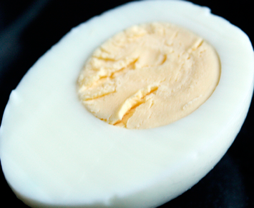
Everyone
Blessed are You, LORD our God, King of the universe, Who sanctified us with his commandments, and commanded us to eat the Pesach.

Slide 250
Eating the egg would begin the Passover meal. We will forgo the meal for time’s sake.
The Pesach offering was lifted up for all gathered to see and the question, “Why do we eat this Pesach offering?” was asked. Everyone present would then retell the story of the Exodus from Egypt and also partake of the matzah and maror.

Slide 251
11. Tzafun (ze - foon)
I hope you have enjoyed your Passover meal, but we must finish our seder. However, I can’t seem to find the Afikomen, and we must have it to finish our seder! Please, has anyone seen the Afikomen?

Slide 252
Pass the Afikomen around
“The matzah that we break is the sharing in the body of Messiah.”
Tzafun means “hidden” and refers to the half of the matzah that was broken earlier and hidden away, buried, during the Yachatz step of our Seder.

Slide 253
Although the Afikomen was implemented in later Messianic tradition - the Greek word means “He came” - near the end of the meal Yeshua took some matzah, broke it and gave it to His disciples:

Slide 254
Reader 5: Now as they were eating, Yeshua took matzah, and after blessing it broke it and gave it to the disciples, and said, “Take, eat; this is My body.” (Matt. 26:26)

Slide 255
We now prepare ourselves to eat some matzah that Yeshua identified with His sacrificial body, given for us. Let us have a moment of solemn silence before our LORD....

Slide 256
It is written that our Lord Yeshua, on the night when He was betrayed, took matzah, and when He had given thanks, He broke it, and gave it to His disciples saying,
This is My body that is given for you; do this in remembrance of Me...

Slide 257
Yeshua told us that He was the Bread of Life, the source of our life and sustenance:
“I am the living bread that came down from heaven. If anyone eats of this bread, he will live forever. And the bread that I will give for the life of the world is my flesh” - John 6:51

Slide 258
This broken piece of matzah recalls the broken heart of Yeshua as He suffered and died as our sin offering upon the altar of the cross. It remembers how our great King was mocked and unjustly flogged; it evokes His agonizing cries as He hung dying on the cross: “Father forgive them...” “I thirst...” “My God, My God – why have You forsaken Me?”

Slide 259
Yeshua our Wounded Healer, who bled out His life so we might live; who took upon Himself the plague of death so that we would be passed over. “For our sake God made Yeshua to be sin who knew no sin, so that in Him we might become the righteousness of God.”

Slide 260
Yeshua gave up His body to be wounded, broken, and killed so that you could have healing, wholeness and life with God forevermore. By His stripes you are healed!

Slide 261
Everyone
Let us thank the LORD our God for the sacrifice of Yeshua’s body that was broken for us:
(eat)

Slide 262
12. Barekh (bear - ekhh)
Now it is time to partake of the Third Cup, the Cup of Redemption, but before we do so, we will offer thanks to the LORD our God for the meal we have shared together, and to remember that food is a gift from God’s altar of which we partake:

Slide 263
Everyone
Blessed are you, LORD our God, master of the universe, Who nourishes the whole world in goodness, with grace, kindness, and compassion. He gives bread to all flesh, for His love endures forever.

Slide 264
And through His great goodness we have never lacked, nor will we lack food forever, for the sake of His great Name. For He is God, who nourishes and sustains all, and does good to all, and prepares food for all His creatures which He created.
Blessed are You, LORD, who nourishes all. Amen.

Slide 265
The third cup recalls God’s promise given to Israel: “I will redeem you with an outstretched arm,” and therefore it is called the “Cup of Redemption” or the “Cup of Blessing.” It was this cup that Yeshua took to symbolize His great sacrifice for us as the true Lamb of God:

Slide 266
Reader 1: And He took a cup, and when He had given thanks, He gave it to them, saying, “Drink of it, all of you, for this is My blood of the new covenant, which is poured out for many for the forgiveness of sins.” (Matt. 26:27-28)
Reader 2: For as often as you eat this bread and drink this cup, you proclaim the Lord’s death till He comes. (1 Cor. 11:26)

Slide 267
The Mishnah says the wine in this cup recalls the shed blood of the korban Pesach that was applied to the doorposts in Egypt, causing the plague of death to pass over. Similarly, Yeshua associated this cup with the blood He would shed on the cross, causing death to “pass over” those trusting in Him.

Slide 268
This is the cup of the new covenant, that is, God’s new agreement to regard all those who trust in the sacrificial death of the Messiah for the forgiveness of their sins to be justified and made right with Him.

Slide 269
This cup symbolizes our participation in the marriage contract, in which the groom, God, signified his pledge by sharing a cup of wine with his bride.

Slide 270
This Cup of Redemption represents God’s New Covenant, and the very blood of Yeshua that was shed for the forgiveness of your sins... Let us recite the traditional blessing, and then drink this cup full of assurance that we are accepted and beloved by our Lord:

Slide 271
Everyone
“Blessed art Thou, LORD our God, King of the universe, Creator of the fruit of the vine.”

Slide 272
13. Hallel (ha - low)
The word Hallel means “praise,” where we get our word Hallelujah from and at this point in our Seder we offer praise and thanks to the LORD God of Israel for the gift of His deliverance as revealed in Yeshua, the Lamb of God who takes away the sins of the world.

Slide 273
Reader 3: He emptied Himself, taking the form of a slave, born in the likeness of men, and humbled Himself by becoming obedient to the point of death, even death on a cross.

Slide 274
Reader 4: Therefore God has highly exalted Him and bestowed on Him the Name that is above every name, so that at the name of Yeshua every knee should bow, in heaven and on earth and under the earth, and every tongue confess that Yeshua the Messiah is LORD, to the glory of God the Father. (Phil. 2:7-11)

Slide 275
It is fitting that on this Passover night we join the great heavenly chorus of angels and those who have gone before us, numbering myriads of myriads and thousands of thousands, who are saying with a loud voice, “Worthy is the Lamb who was slain, to receive power and wealth and wisdom and might and honor and glory and blessing!”

Slide 276
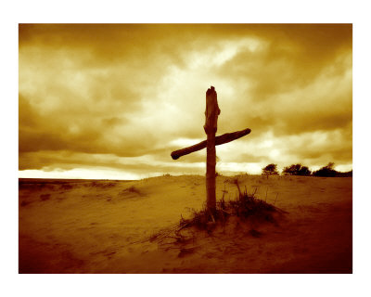
Worthy is the Lamb that was slain,
Worthy is the Lamb that was slain,
Worthy is the Lamb that was slain,
To receive:
Power and riches and wisdom and strength,
Honor and glory and blessing!
Worthy is the Lamb,
Worthy is the Lamb,
Worthy is the Lamb that was slain
Worthy is the Lamb!

Slide 277
We now come to the fourth and final cup of wine for the Seder. This cup represents the fourth “I will” statement of Exodus 6:6 - “I will acquire you as a nation.”

Slide 278
Since Yeshua told His disciples that He would not drink the fourth cup but promised to do so with them in the coming Kingdom (Matt. 26:29), this cup may be called the “Cup of Restoration,” since it will be fully savored only after “all Israel shall be saved.” (Rom. 11:26).

Slide 279
We pour this fourth cup of wine and recite portions from the second half of the Hallel (Psalms 115-118), praising the LORD for His kindness and grace to us:

Slide 280
“May you be blessed by the LORD, who made heaven and earth!”

Slide 281
Reader 5: I love the LORD, because He has heard my voice and my pleas for mercy! Because He inclined His ear to me, therefore I will call on Him as long as I live.
Reader 1: Praise the LORD, all nations! Extol Him, all peoples! For great is His love toward us, and the faithfulness of the LORD endures forever. Praise the LORD!

Slide 282
Reader 2: Oh, give thanks to the LORD, for He is good; for His steadfast love endures forever! Let Israel say, “His steadfast love endures forever.”
Reader 3: The stone that the builders rejected has become the Cornerstone. This is the LORD’s doing; it is marvelous in our eyes. This is the day that the LORD has made; let us rejoice and be glad in it!

Slide 283
Everyone
O Israel, trust in the LORD! He is their help and their shield! O house of Aaron, trust in the LORD! He is their help and their shield! You who fear the LORD, trust in the LORD! He is their help and their shield!

Slide 284
After we pour our fourth cup of wine, we will also fill an extra cup for the prophet Elijah, who will herald the return of the LORD Yeshua at the End of the Age.

Slide 285
This fourth cup of restoration would have been the cup that Jesus would not have drunk with His disciples but said that He would drink it with them in His Father’s Kingdom (Mt 26:29)

Slide 286
Look! I will send Elijah the prophet before the coming and great day of the LORD. (Malachi 3:23)
After the cup is filled, we ask a
child to open the front door to
see if Elijah has come and to
welcome him to our Seder.

Slide 287
Everyone
Then I saw heaven opened, and behold, a white horse! The One sitting on it is called Faithful and True, and in righteousness He judges and makes war. His eyes are like a flame of fire, and on His head are many diadems, and He has a name written that no one knows but Himself.

Slide 288
He is clothed in a robe dipped in blood, and the name by which He is called is The Word of God. And the armies of heaven, arrayed in fine linen, white and pure, were following Him on white horses.

Slide 289
From His mouth comes a sharp sword with which to strike down the nations, and He will rule them with a rod of iron. And He will tread the winepress of the fierce fury of the wrath of God, the Ruler over All, who is the LORD God Almighty.

Slide 290
On His robe and on His thigh He has a name written, King of kings and Lord of lords. And with the breath of His lips He will slay the wicked.”
(Revelation 19:11-16)

Slide 291
We are now ready to drink from the Fourth Cup, the Cup of Restoration. We drink this cup in anticipation of the coming day when we shall do so with our Lord and Savior, Yeshua the great King of kings, and Lord of lords.
“I will lift up the cup of salvation and call on the Name of the LORD”

Slide 292
This cup represents our great hope that soon the Messiah will return for us, and soon He will fulfill the kingdom promises given to the Jewish people. In that great day, all Israel shall be saved, and we shall reign with Him in the millennial kingdom of God upon the earth. Let us all recite the blessing:

Slide 293
Everyone
“Blessed art Thou, LORD our God, King of the universe, Creator of the fruit of the vine.”

Slide 294
Reader 4: For the Lord Himself shall descend from heaven with a shout, with the voice of the archangel, and with the shofar blast of God: and the dead in Messiah shall rise first: Then we which are alive and remain shall be caught up together with them in the clouds, to meet the Lord in the air: and so shall we ever be with the Lord.’’
(1Thess. 4:16-17)

Slide 295
14. Nirtzah (near - za)
Our Passover Seder is now complete; its customs and laws fulfilled. Lord, grant us peace that we, each one of us, may do Thy will. O pure and Holy One, raise up the lowly and make us free; replant in Zion in love Thy vine branch, near to Thee.

Slide 296
Fulfill, O LORD, the desires and requests of Thy servants, and grant us in this world knowledge of Thy truth, and in the world to come, everlasting life. May Thou who hast broken Pharaoh’s power and set Israel free, soon crush Satan under our feet. O Lord, speedily, and in our days...

Slide 297
Reader 5: Then I saw a new heaven and a new earth, for the first heaven and the first earth had passed away, and the sea was no more. And I saw the holy city, New Jerusalem, coming down out of heaven from God, prepared as a bride adorned for her husband.

Slide 298
Reader 1: And I heard a loud voice from the throne saying, “Behold, the dwelling place of God is with man. He will dwell with them, and they will be His people, and God Himself will be with them as their God.”

Slide 299
Reader 2: He will wipe away every tear from their eyes, and death shall be no more, neither shall there be mourning, nor crying, nor pain anymore, for the former things have passed away.”

Slide 300
“Now to the One who is able to keep you from falling, and to cause you to stand, rejoicing, without blemish before His glorious presence, to the only God our Savior through Yeshua the Messiah, our Lord and great Lamb of God, be glory, majesty, power, and authority, before all time, and now, and for all eternity. Amen.”

Slide 301
Worthy, You are worthy
King of kings, Lord of lords, You are worthy
Worthy, You are worthy
King of kings, Lord of lords, I worship You.
Holy, You are holy
King of kings, Lord of lords, You are holy
Holy, You are holy
King of kings, Lord of lords, I worship You.
Jesus You are Jesus
King of kings, Lord of lords, You are Jesus
Jesus You are Jesus
King of kings, Lord of lords, I worship You.

